Slide 1
Chapter 4 Introduction
Business Intelligence & Analytics

Slide 2
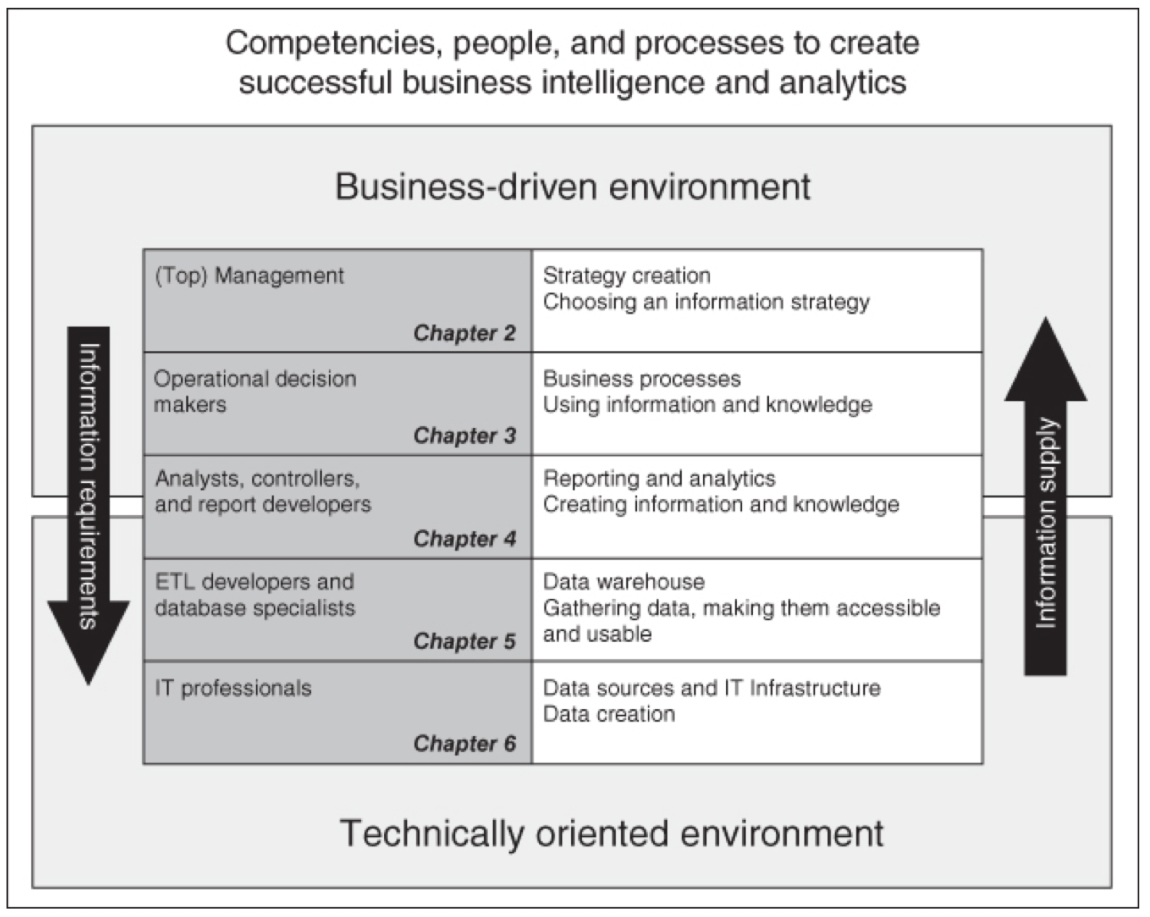
Review
Levels
Chapter 2: Strategic
Chapter 3: Functional
Chapter 4: Analytic
Chapter 5: Data Warehouse
Chapter 6: Data Sets
Notes:
Note that we are moving from high level business decisions down to the technical level of the organization. This is important because it is the strategy that should influence all other activities and not the other way around. as we’ll see in future chapters, using the technical environment as the starting place is a sure way to waste time, effort and money.

Slide 3
Review
Levels
Chapter 2: Strategic
Chapter 3: Functional
Chapter 4: Analytic
Chapter 5: Data Warehouse
Chapter 6: Data Sets
Notes:
Note that we are moving from high level business decisions down to the technical level of the organization. This is important because it is the strategy that should influence all other activities and not the other way around. as we’ll see in future chapters, using the technical environment as the starting place is a sure way to waste time, effort and money.

Slide 4
Chapter 4:
What can we expect an advanced analytical organization to be able to do?
Which methods can generate which types of decision support.
Create a basis for dialogue between the company and the analyst.
Make it possible for the company to formulate exactly what it wants from its BA function.
Notes:
Build a picture of who the analyst is and what they should be able to do.

Slide 5


